Slide 1

Box Office Performance Prediction
Guided By:
Mr. Anay Tamhankar
Mr. Prasad Deshmukh
Submitted By:
Ajay Hoke (230343025019)
Amisha Kotkar (230343025027)
Sakshi Patil (230343025037)
Anjali Sul (230343025050)
‹#›

Slide 2
Introduction
The purpose of our project is to develop a robust and accurate predictive model for forecasting the box office performance of movies. We aim to provide valuable insights to the film industry, investors, and studios to make informed decisions regarding cast, budget allocation, genre selection, and marketing strategies.
In today's competitive film industry, the need for precise box office revenue prediction is paramount. Studios and investors require reliable forecasts to optimize their investments, while moviegoers seek diverse and high-quality entertainment options.
Studios and producers can optimize decisions for casting, budgets, and marketing, enhancing profitability. Investors reduce financial risks with ROI insights. Audiences enjoy a wider film selection, while critics gain tools for more objective assessments.

Slide 3
Problem Statement
We aim to leverage advanced data analytics and machine learning techniques to predict the box office performance of upcoming movies. By analyzing various factors such as genre, cast, budget and release date, our model aims to provide valuable insights to the film industry, assisting stakeholders in making informed decisions for maximizing their movie's success at the box office.
The film industry relies heavily on box office performance predictions to make informed decisions regarding production budgets, marketing strategies, and distribution plans. Accurate revenue predictions can significantly impact the success and profitability of movie projects.
Our model will focus on predicting box office revenue based on historical data and movie attributes such as cast, budget, genre and so on.
Success will be measured by the model's ability to provide accurate revenue predictions, reducing forecasting errors. Efficiency and timeliness of predictions will also be considered to support real-time decision-making.

Slide 4
Flowchart to Build Model
Data Study and Data Cleaning
TMDB Dataset
Data Transformation
Log Transformation
Machine Learning Algorithm
Random Forest
Decision Tree
XG Boosting
Data Visualization

Slide 5
Technology Platforms Used
Python : Our primary programming language for data preprocessing, machine learning model development, and analysis.
Machine Learning (ML) : Utilized for predictive modeling and generating revenue forecasts based on various movie attributes.
MongoDB : MongoDB serves as our database system, offering flexibility and scalability for handling large volumes of movie-related data.
Tableau : Our data visualization tool, enabling the creation of interactive dashboards and insightful visual representations of our predictions and analysis results.

Slide 6
Exploratory Data Analysis and Feature Engineering
Univariate Analysis:
Checking null values, plotting graph and checking the distribution.
2) Bivariate Analysis:
Plotting graph and Checking the correlation with the output variable for each input variable.
3) Dropping irrelevant features.
4) Scaling the features:
Scaled the features using log transformation for better distribution of data.
5) Data Pre-Processing on columns.
6

Slide 7
Number of columns 23, with object type and few columns in JSON format.
Analysis of Revenue Column (Output Variable):
1) checked null values.
2) Checked distribution by plotting histogram.
3) Scaled the values using log transformation.
Analysis of input variables:
Belongs to collection- belongs to collection as 1 and does not belongs to collection as 0.
Budget- filled the null values with median.
Genres- Extracted the data and created genre_rank and num_of_genres columns.
Homepage- Has homepage as 1 and does not have a homepage as 0.
Original language- Released in English as 1 and not in English as 0.
Production companies- Extracted data and created columns like top_studio, studio_rank, num_top_studio.
Production countries- US produced as 1 and not a US produced as 0. also the number of countries used for production.

Slide 8
Release data- Extracted year, day of week, day of year and week of year. Also created columns year wise , day wise and weather wise.
Runtime- Replaced 0 values with median.
Spoken languages- Most of the movies are in English (87.3%) and created column of number of languages spoken in a particular movie.
Tagline- Has a tagline as 1 and does not have a tagline as 0.
Title- created a column by checking the length of the title.
Keywords- has keywords as 1 and does not have keywords as 0.
Cast- Extracted data and created columns such as num_of_cast, top_lead_actor, num_of_top_actors, actorRanks, top_actorRank.
Crew- Extracted data and created columns for different crew members.
Dropped columns- imdb_id, origina_title, overview, popularity, poster_path and status.

Slide 9
Machine Learning Algorithms
We have selected three different machine learning models for performance evaluation:
1.Random Forest
2.Decision Tree
3.XGBoost.
The primary objective is to identify the model that delivers the highest predictive accuracy and best meets the requirements of our project.

Slide 10
Evaluation Metrics
In the machine learning models, we have used following evaluation metrics before and after the hyperparameter tuning :
Mean Squared Error
Root Mean Squared Error
Mean Absolute Error
Test Set Accuracy (from Mean Absolute Percentage Error)

Slide 11
Decision Tree
It's a simple yet powerful model that makes decisions based on a sequence of rules applied to input features.
The algorithm constructs a tree-like structure where each internal node represents a decision based on a particular feature, and each leaf node represents an outcome.
Accuracy Before Tuning | Accuracy After Tuning
89.24% | 89.87%
Root Mean Squared Error Before Tuning | Root Mean Squared Error After Tuning
2.1553 | 1.9080

Slide 12
2 .Random Forest Tree
The random forest algorithm works by constructing a number of individual decision trees and making a prediction based on the average across them all, tending to be more accurate and reducing the error that may be seen in just a single decision tree.
Accuracy Before Tuning | Accuracy After Tuning
91.914% | 91.833%
Root Mean Squared Error Before Tuning | Root Mean Squared Error After Tuning
1.058 | 1.0619

Slide 13
3.XG Boosting
This is a library designed for efficiency and meant to be great for working with large amounts of data as it can supposedly run quickly and accurately
XGBoost implements algorithms under the gradient boosting framework and provides a parallel tree boosting to solve problems.
Accuracy Before Tuning | Accuracy After Tuning
91.18% | 91.71%
Root Mean Squared Error Before Tuning | Root Mean Squared Error After Tuning
1.0811 | 1.161

Slide 14
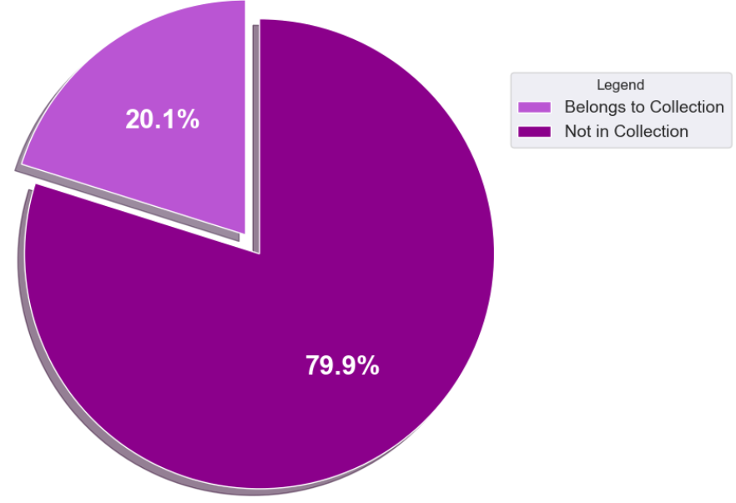
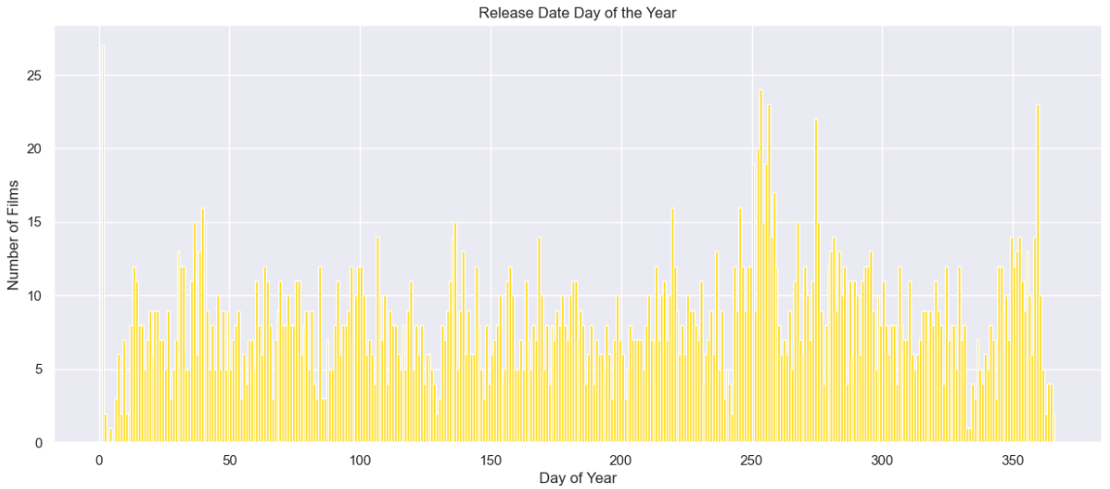
Data Visualization
Using Matplotlib in Python :
Within our Python code, we've employed Matplotlib for generating customized and programmatic visualizations.Matplotlib enhances our data exploration and model evaluation processes, offering flexibility and control.
Using Tableau For Interactive Dashboards :
We have harnessed the power of Tableau to create interactive and insightful dashboards.Tableau enables us to visualize complex movie data, aiding in understanding trends and patterns.

Slide 15
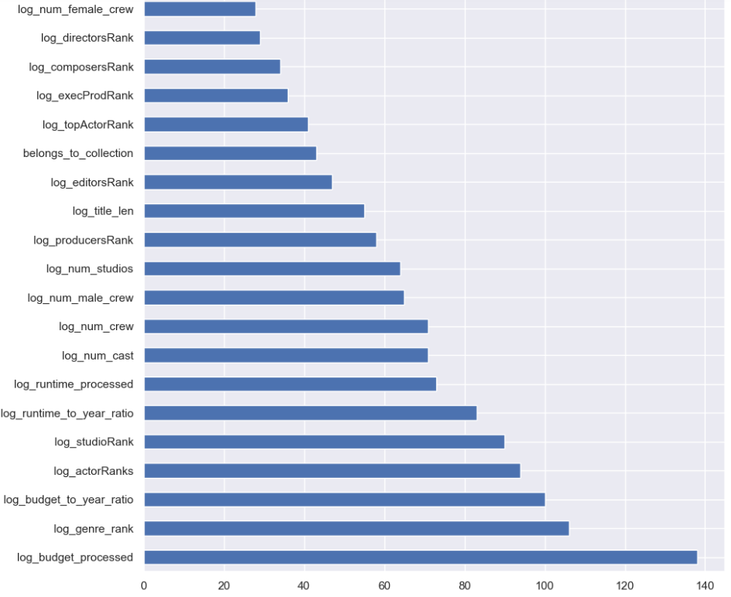
Feature Importances
Feature ranking:
1. log_budget_processed (138.000000)
2. log_genre_rank (106.000000)
3. log_budget_to_year_ratio (100.000000)
4. log_actorRanks (94.000000)
5. log_studioRank (90.000000)
6. log_runtime_to_year_ratio (83.000000)
7. log_runtime_processed (73.000000)
8. log_num_cast (71.000000)
9. log_num_crew (71.000000)
10. log_num_male_crew (65.000000)
11. log_num_studios (64.000000)
12. log_producersRank (58.000000)
13. log_title_len (55.000000)
14. log_editorsRank (47.000000)
15. belongs_to_collection (43.000000)
16. log_topActorRank (41.000000)
17. log_execProdRank (36.000000)
18. log_composersRank (34.000000)
19. log_directorsRank (29.000000)
20. log_num_female_crew (28.000000)

Slide 16
Future Extensions
Enhancing Predictive Accuracy with Spark
We currently leverage Apache Spark for efficient data preprocessing, We plan to extend Spark's capabilities for better predictive modeling in the future.
Natural Language Processing (NLP) for Reviews (2-3 months)
Enhancing predictions by analyzing movie reviews to capture audience sentiment. Audience sentiment is a key driver of box office success.
User Behavior Analysis (3-4 months)
Predicting success by analyzing user behavior on online platforms.Understanding user preferences is crucial.

Slide 17
Conclusion
In conclusion, our Box Office Performance Prediction project successfully tackled the complexities of the movie industry. We overcame challenges in data management, model optimization, and real-time integration, which, in turn, fostered our professional growth.

Slide 18
References
Tableau Repository :
https://public.tableau.com/app/profile/ajay.hoke/viz/BoxofficeFinalproject11/Dashboard2?publish=yes
Other References :
https://www.kaggle.com/competitions/tmdb-box-office-prediction/rules
https://www.tableau.com/blog/beginners-guide-tableau-public

Slide 19
Thank you
‹#›

